Slide 1

TDA Presentation
By Elvis Kimara

Slide 2
Problem Definition
How can we bring topological data analysis into deep neural networks and use it as a viable method for shape reconstruction.
We care because we want to extract zero dimensional features using persistent diagrams to get traits that are most prevalent
Our research question is: can this method help mitigate the problem of ghost geometries during shape reconstruction
Notes:
ensure neural networks preserve and accurately represent the underlying topological characteristics of data, crucial for applications in 3D shape analysis and point cloud processing.
In topological data analysis (TDA), "zero dimensional" generally refers to features that do not have any holes; they are the simplest type of features. Specifically:
0-dimensional features are connected components. In the context of persistent homology, the birth time of a 0-dimensional feature is when a new component appears, and the death time is when it merges with another component as you vary a parameter (like a threshold in a filtration process).
1-dimensional features would be loops or holes in the data.
2-dimensional features would refer to voids or trapped volumes.
When the term "zero dimensional features" is used in conjunction with persistent diagrams in TDA, it usually means focusing on the creation and merging of connected components as a way to understand the underlying topology of the data. For shape reconstruction, ensuring that the 0-dimensional features (i.e., connected components) of a shape are accurately captured can be crucial, as they define the coherence of different parts of the shape.

Slide 3

My Role
Run multiple jobs with different losses, and networks to test our methodology

Slide 4

Papers Read
Implicit Geometric Regularization for Learning Shapes
Divergence guided shape implicit neural representation for unoriented point clouds
Topology-controllable Implicit Surface Reconstruction Based on Persistent Homology
Neural Splines- Fitting 3D Surfaces With Infinitely-Wide Neural Networks

Slide 5

Methodology
Use TDA losses like: 1, 2, combo_1_wasserstein
combo_2_wasserstein
combo_1_2
combo_1_2_wasserstein
wasserstein
And enforce TDA in MLP.

Slide 6

Loss Functions:
Combo_1_Wasserstein:
Combines a specific topological feature capture method ("1") with the Wasserstein distance to align learned representations closely with original data's topology.
Combo_2_Wasserstein:
Similar to Combo_1_Wasserstein but uses a different set of topological features ("2") for a more diverse representation, also minimized with the Wasserstein distance.
Combo_1_2:
Merges two topological feature capture methods ("1" and "2") for a broad and rich topological representation, focusing on diversity without directly using the Wasserstein distance.
Combo_1_2_Wasserstein:
A comprehensive approach that combines both "1" and "2" with the Wasserstein distance, aiming for a topologically accurate and diverse representation that closely matches the original data.
Wasserstein:
Focuses solely on minimizing the Wasserstein distance between persistence diagrams of the original and learned data, emphasizing topological similarity and feature persistence.
Notes:
topological_new_loss_2: Minimizes the birth times of diag2's features and the persistence (difference between death and birth times) of these features. The aim could be to encourage features in diag2 to appear earlier and persist longer, reflecting a more robust topological structure.
wassersterin_metric: Computes the Wasserstein distance using the gd.wasserstein.wasserstein_distance function, which is likely from a library like GUDHI or similar, dedicated to TDA. This distance measures how much "effort" is required to transform one diagram into the other, hence quantifying their similarity.
topological_new_loss: Appears to aim for a balance between promoting persistence of significant features (by penalizing the sum of negative differences −1×(b−d) for significant pairs to avoid negative values) and minimizing the persistence of noise (by adding the sum of d−b for noise pairs). This function segregates features into significant and noise based on a threshold, likely aiming to reduce the impact of transient or less relevant topological features

Slide 7
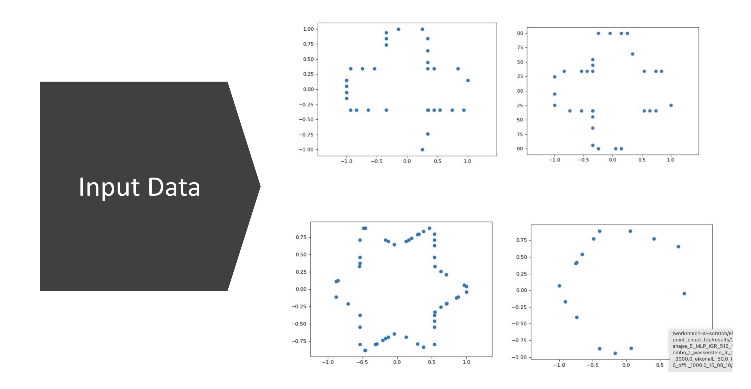

Slide 8
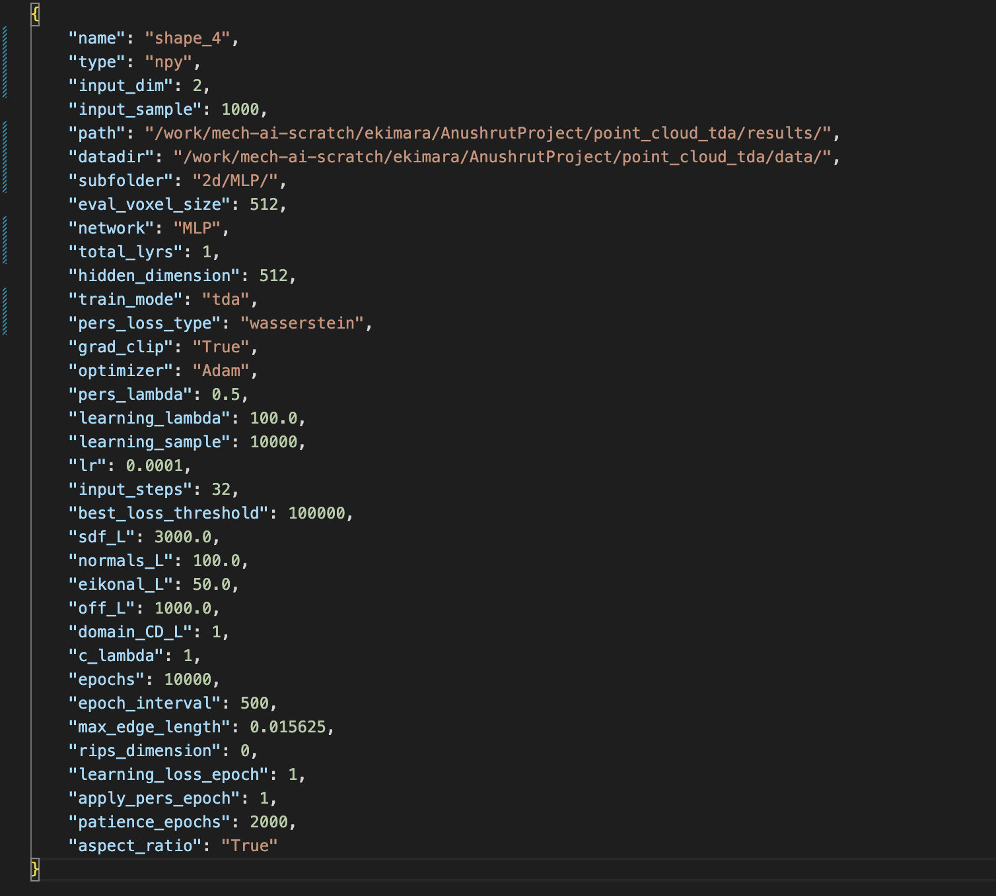
Scripts

Slide 9
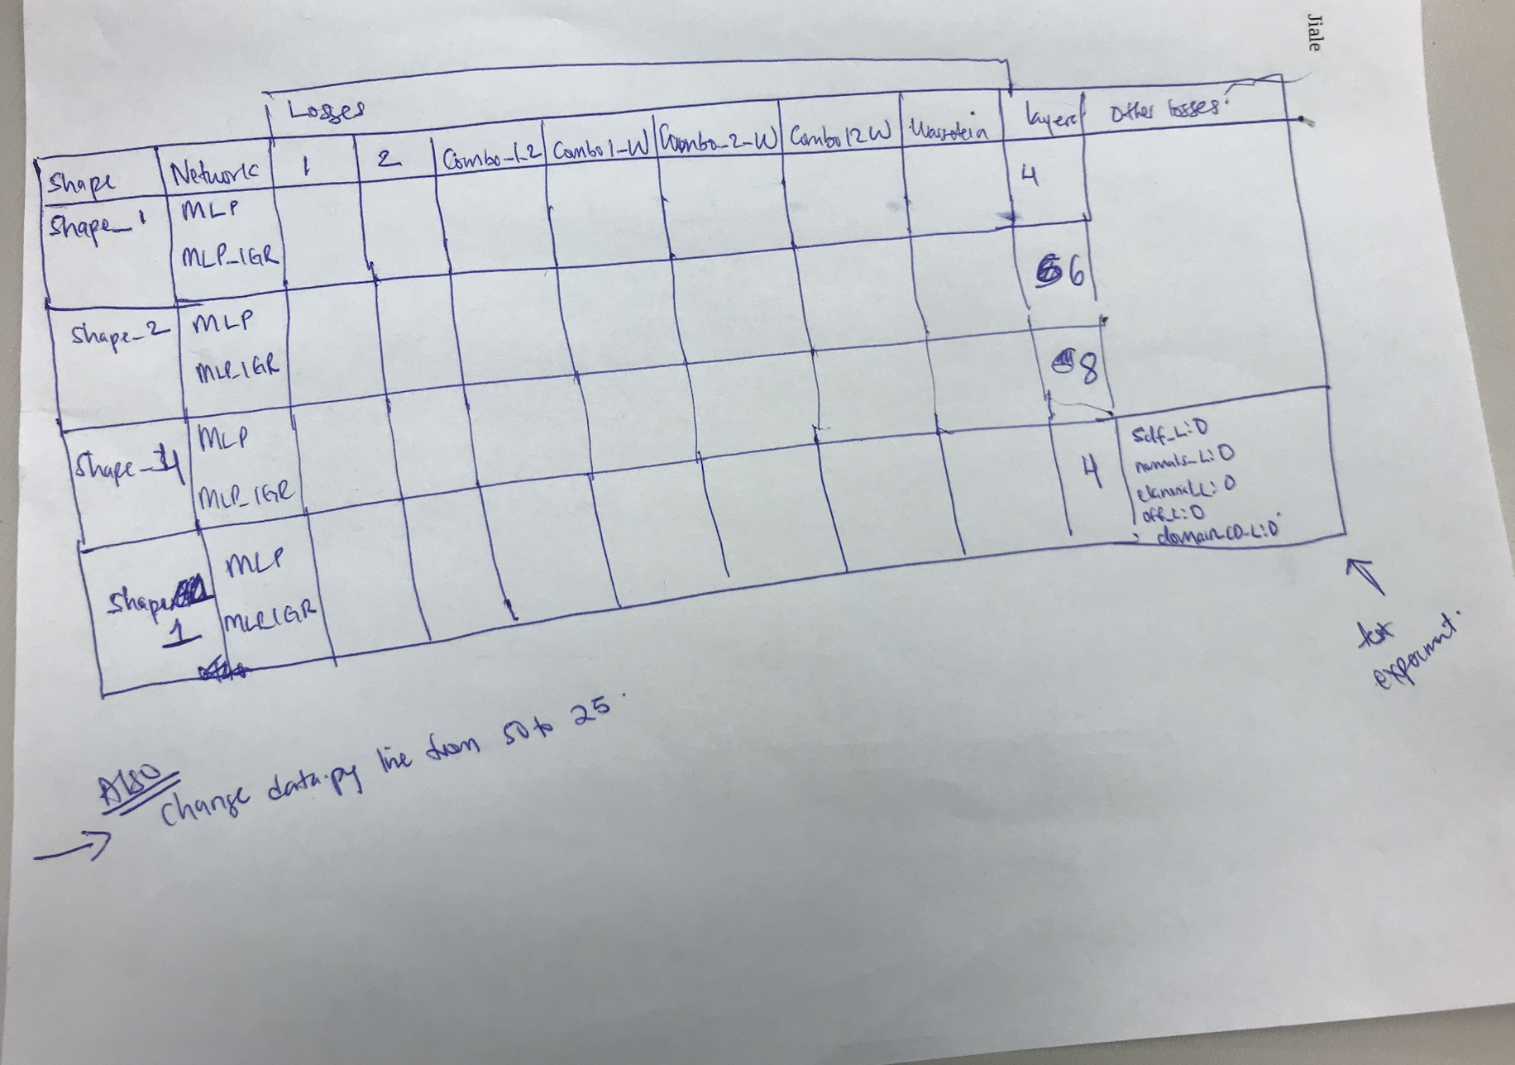
Jobs to Run

Slide 10


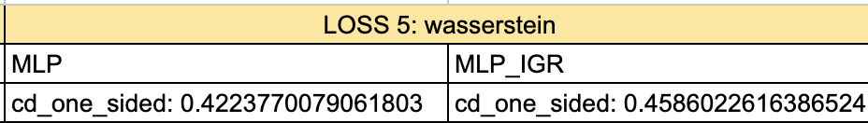
Loss comparisons

Slide 11
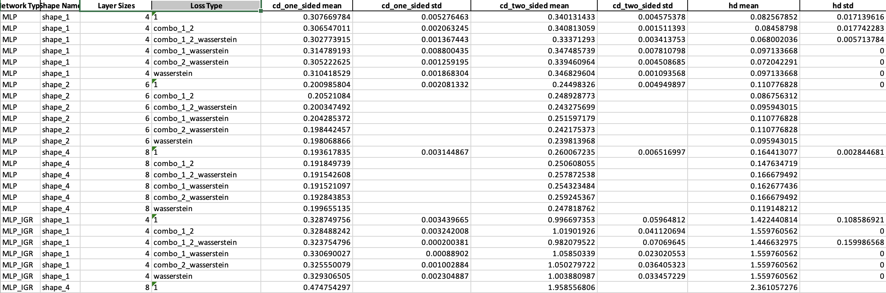
Loss comparisons

Slide 12
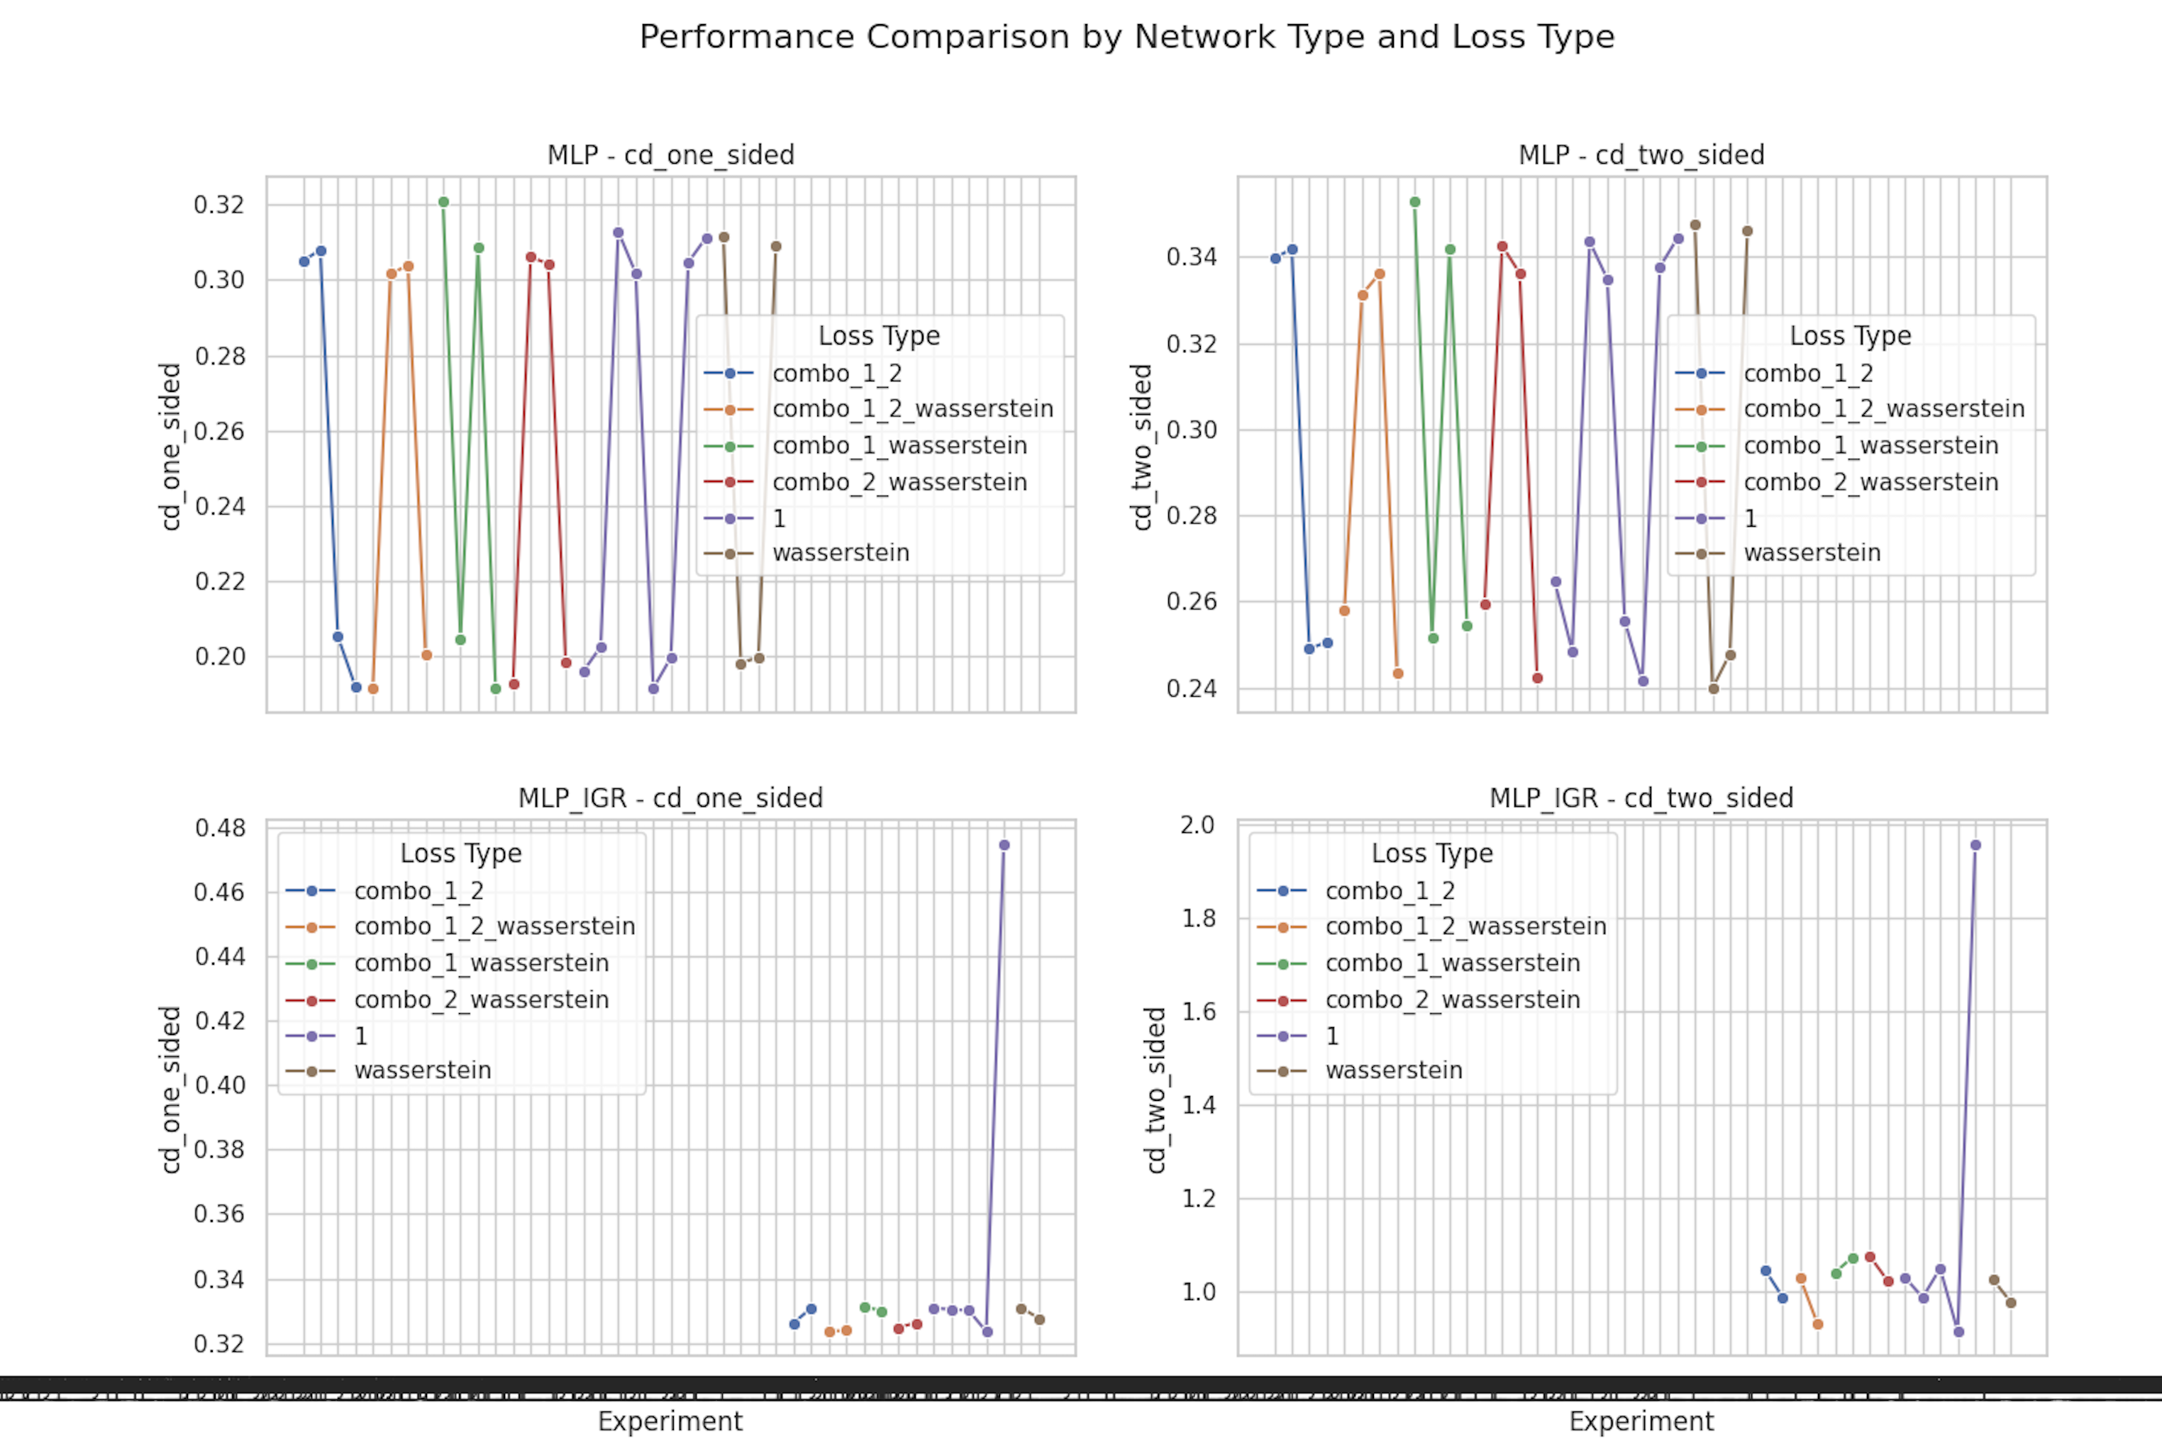

Slide 13
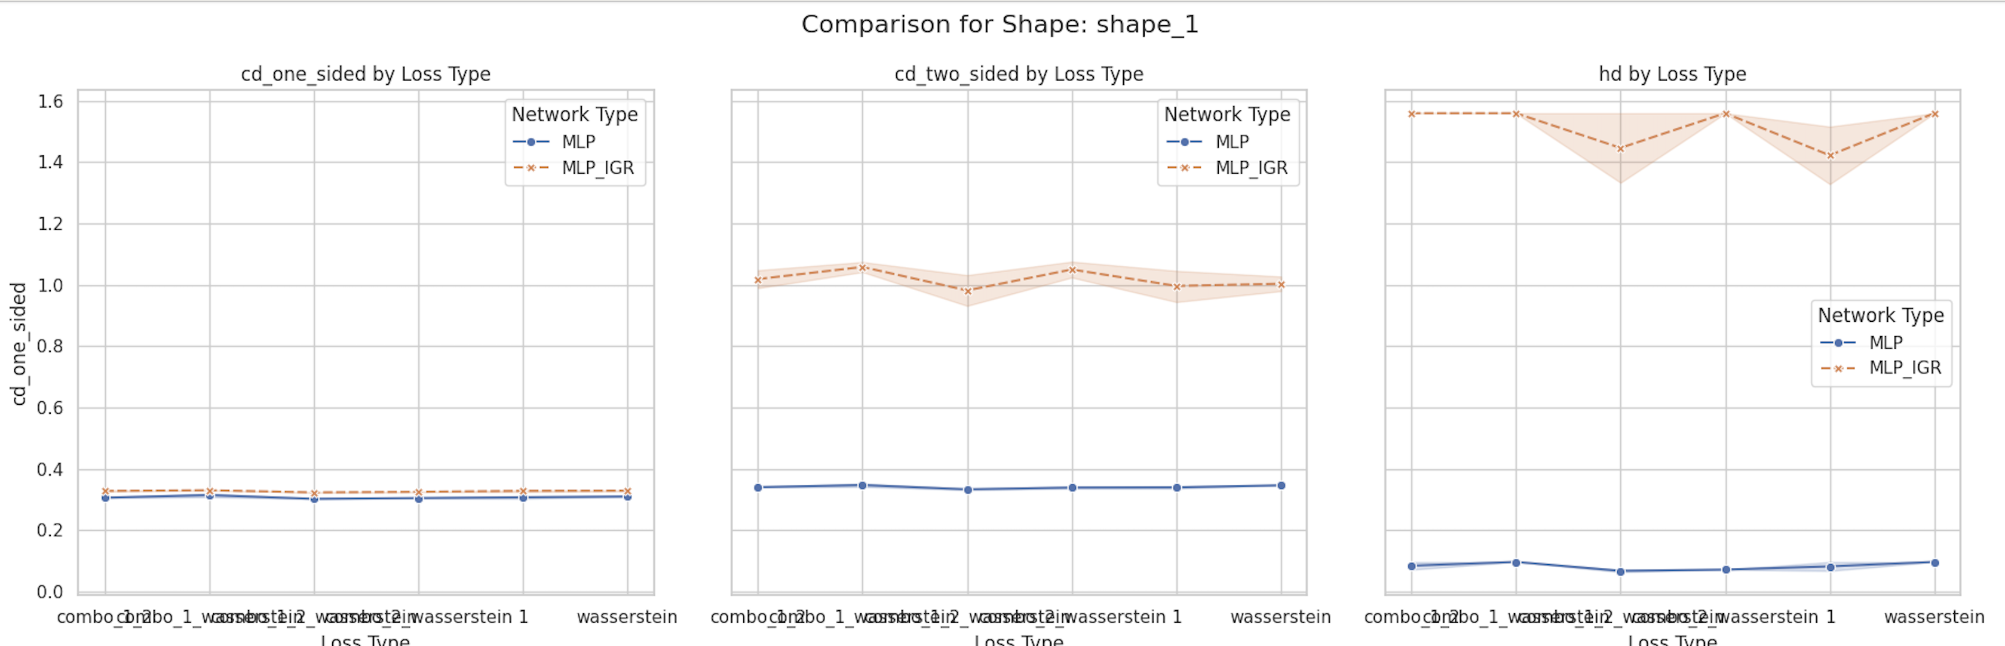

Slide 14
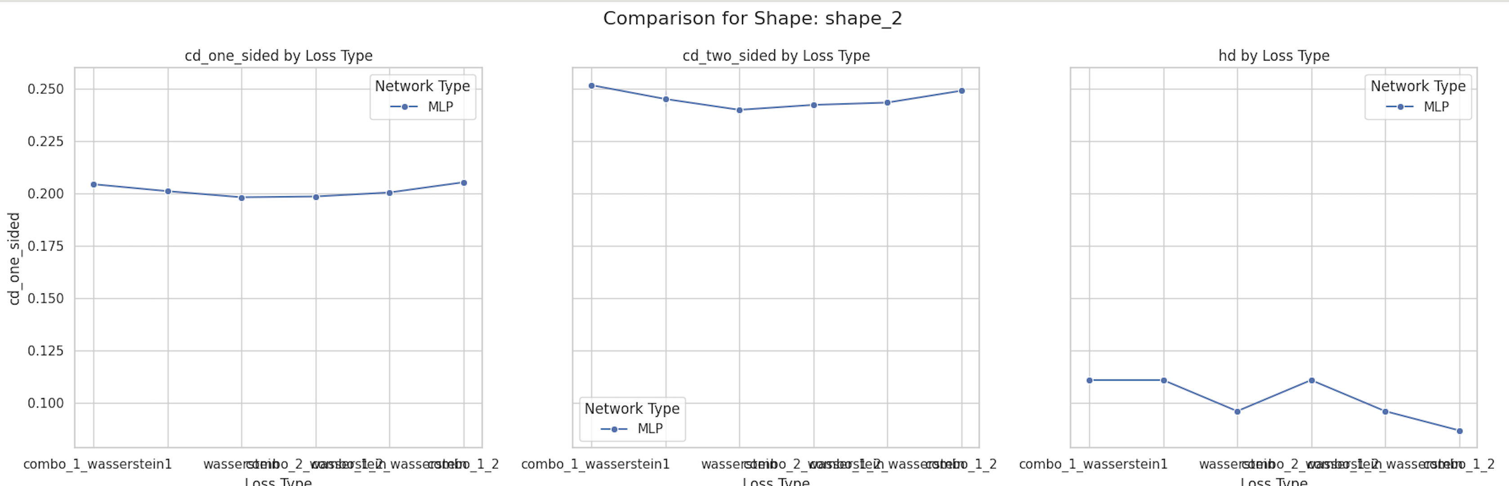

Slide 15
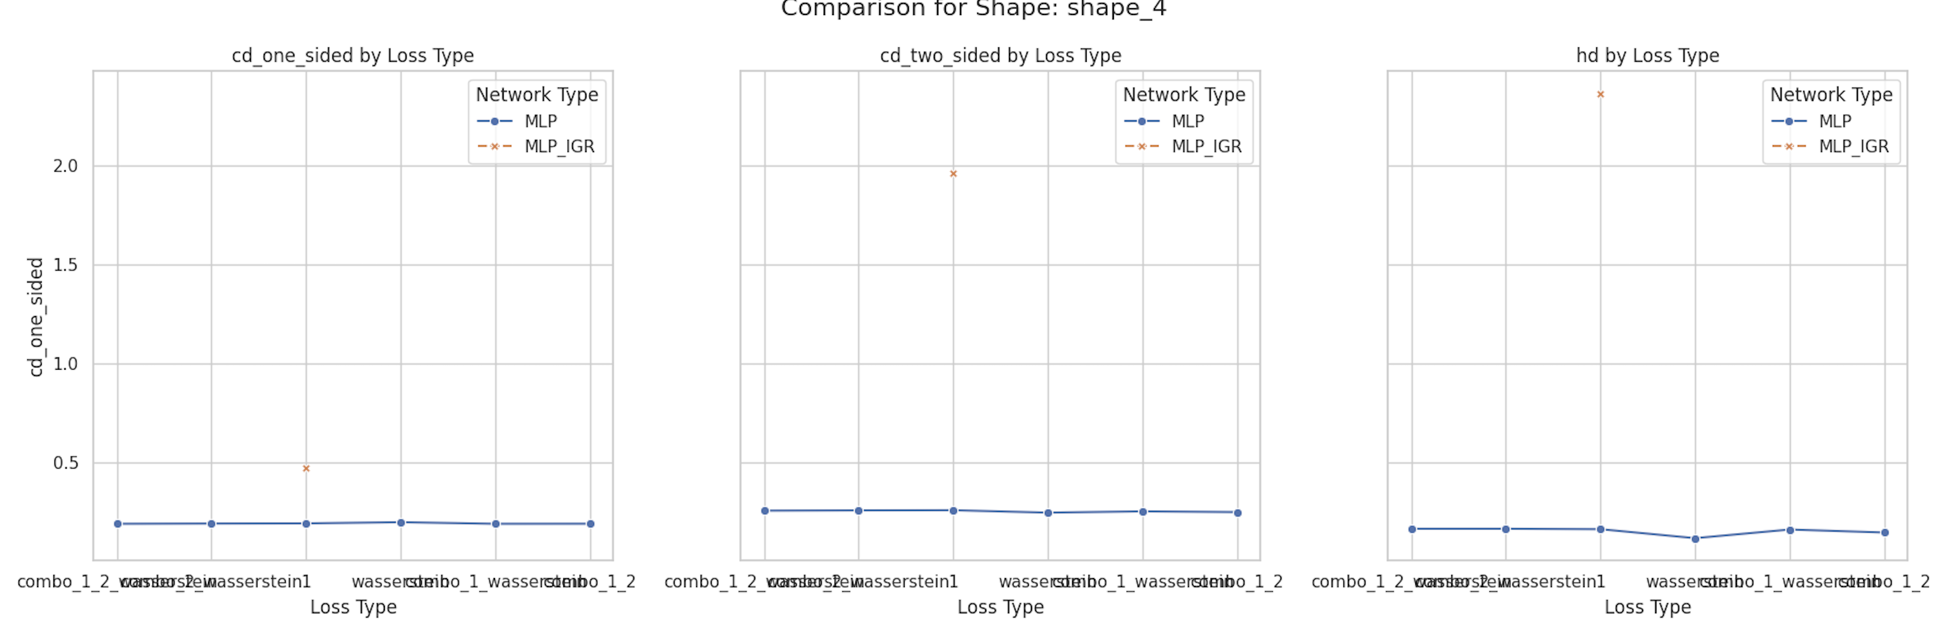

Slide 16
Next steps
Meet Anushrut later this week to discuss what jobs to run next. More complex shapes, layers, ask questions, and set week goals.
Make better graphs for data analytics
Done some early work on
Vanilla PointNET AE for point cloud shape reconstruction
MLP for 3D reconstruction using direct SDF loss (matching cubes for rendering)
MLP for 3D reconstruction using Eikonal Equation (matching cubes for rendering)

Slide 17
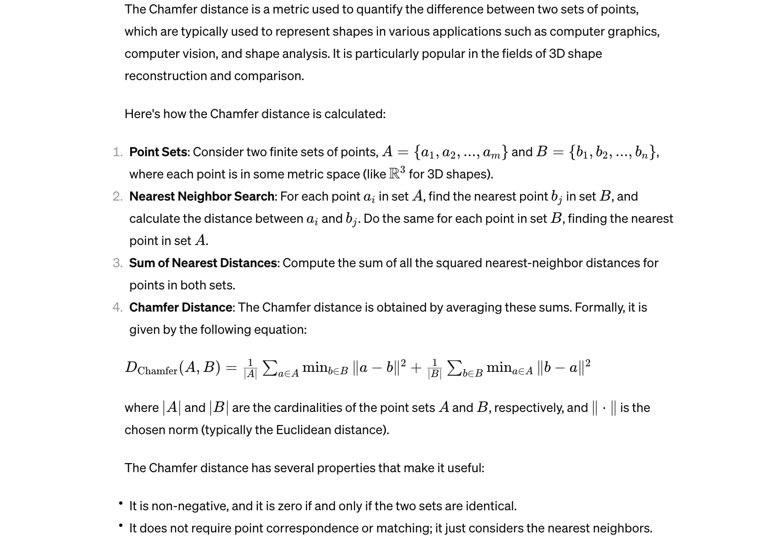
Chamfer distance

